Slide 1
My terrible time
Suffered by: Kanishka Ramanan

Slide 2
Where it all went wrong
Project Idea: Create a code that tracks the financial statements of companies and compares that to their stock’s performance
The Plan: Pull any S&P 500 company’s quarterly or annual financial statements from the SEC, and analyze certain accounting ratios (e.g. current ratio, earnings per share, etc.). Then track that against the movement of stocks in the days following the release of the financial statements using a 5 year Dataset of all 500 companies on the S&P 500 found on kaggle.com

Slide 3
How it went right
Thanks to Nick, I was able to find a code online that used BeautifulSoup to parse through XBRL formatted Financial Statements on the SEC’s EDGAR
I was able to adapt the code to work through a list of companies and years, query all the financial statements for each year for those companies, filter out only the financial line entries and extract it to a CSV file
I was also able to code the analysis and graphs to be dynamically created for each company and present them at the same time

Slide 4
How it went wrong
In each financial statement, there are multiple entries of the same name. One relates to the current period and then others relate to previous periods. They can only be identified by their ContextRef ID, which is can also be extracted as a column in the CSV
However, each company uses different formats for the CRef ID, and even switch formats between years. Here are some examples from companies I downloaded:
Microsoft 2017: C_0000789019_20170701_20170930
Microsoft 2016: eol_PE8528----1610-Q0011_STD_0_20130916_0
Apple 2017: FI2016Q4
Apple 2016: eol_PE2035----1610-Q0006_STD_0_20160326_0
3M 2017: As_Of_12_31_2016
Nvidia 2016: FD2016Q3QTD

Slide 5
How I overcame
Since I did not have to time to create a code that can dynamically search through the CRef ID and find the date/quarter between the different formats and potential formats where each date/quarter is presented differently and in different locations of the string, I instead decided to hard code it.
I was working on Microsoft, so I decided to hard code it to the pre-2016 format just to get it to work.
I also decided to use only annual statements, because for quarterly statements any income/expense entries (like Net Income) has multiple entries with the same end date, since one is the income for the quarter and the other is the total income for the current year.

Slide 6
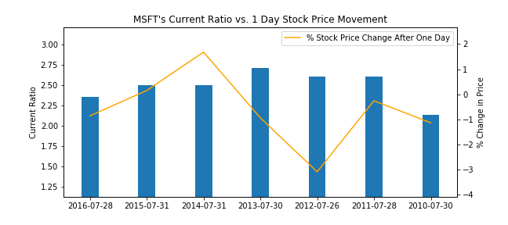
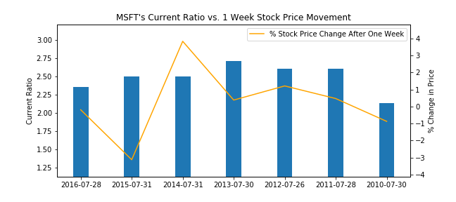
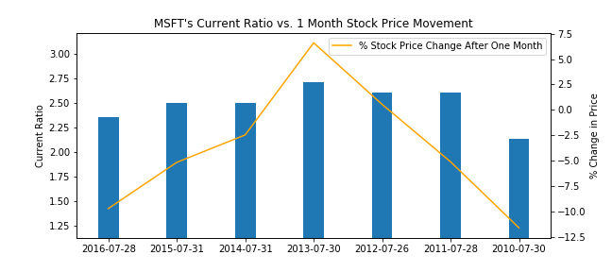
Current Ratio Bar Chart
The Current Ratio is a measure of a company’s liquidity, and is measured by dividing their Current Assets by Current Liabilities. This is used to judge the health of a company and it’s ability to meet it’s short term obligations

Slide 7
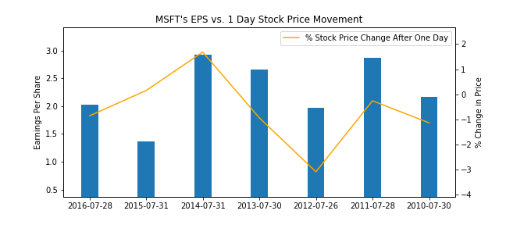
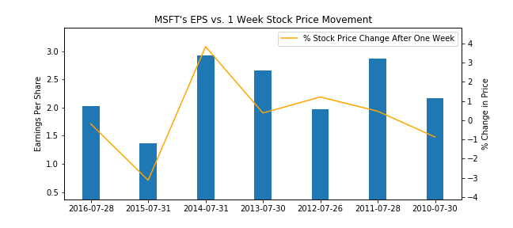
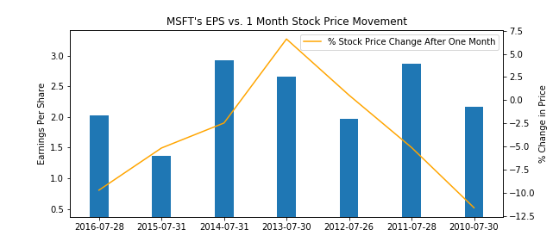
Earnings per share Bar Chart
Earnings Per Share is calculated as a company’s net income divided by their total number of stock outstanding. This is one of the most common ratios used to predict Stock Price Movement.

Slide 8
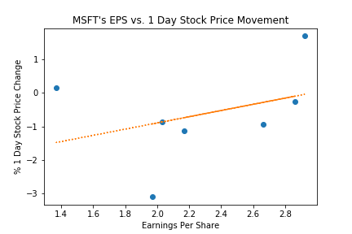
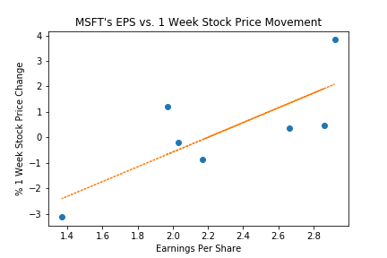
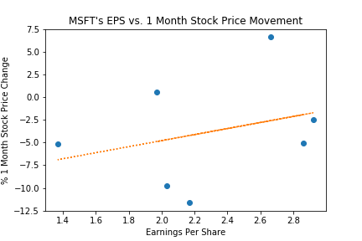
Earnings per share scatter plot
From this, we can see that EPS most accurately predicts stock movement in the week following it’s reporting

Slide 9
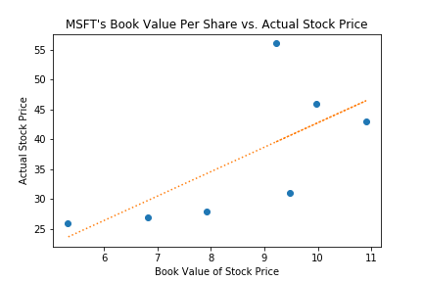
Book value per share
Book Value Per Share gives the accounting value per share. It is calculated by dividing the Stockholder’s Equity by the total number of stocks outstanding. This will give the base value of what the stock should be valued at.
The actual Stock Price is determined by the market, and is usually influenced by things as discounted cash flows of future dividends, confidence in the company, and overall market sentiment
As we can see, there is almost no relation between the what it should be priced at and the actual Stock Price

